Slide 1
Monolithic Kernel/Microkernel

Slide 2
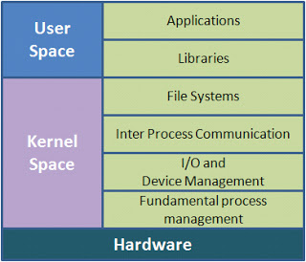
Monolithic kernel

Slide 3
Monolithic kernel
Older approach(Unix, MS-DOS)
Runs every basic system service like process and memory management, interrupt handling and I/O communication, file system
The inclusion of all basic services in kernel space has three big drawbacks.
The kernel size increase.
Lack of extensibility.
The bad maintainability.

Slide 4
Monolithic kernel
Bug-fixing or the addition of new features means a recompilation of the whole kernel
Time and resource consuming
Kernel Image = (Kernel Core+Kernel Services). When system boots up entire services are loaded and resides in memory.

Slide 5
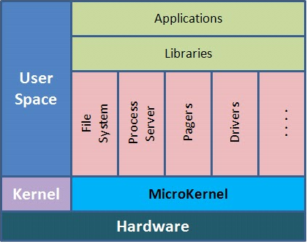
Microkernel

Slide 6
Microkernel
Reduce the kernel to basic process communication and I/O control
other system services reside in user space in form of normal processes (as so called servers)
the servers do not run in kernel space anymore, so called ”con-text switches” are needed, to allow user processes to enter privileged mode (and to exit again)
Kernel Image = Kernel Core. Services are build in to special modules which can be loaded and unloaded as per need.

Slide 7
Difference between Microkernel/Monolithic kernel
Monolithic kernel is a single large processes
It runs entirely in a single address space.
It is a single static binary file.
All kernel services exist and execute in kernel address space.
The kernel can invoke functions directly.
The examples of monolithic kernel based OSs are Linux, Unix

Slide 8
Difference between Microkernel/Monolithic kernel
In Microkernels, the kernel is broken down into separate processes, known as servers.
Some of the servers run in kernel space and some run in user-space.
All servers are kept separate and run in different address spaces.
The communication in microkernels is done via message passing.
The servers communicate through IPC
Servers invoke "services" from each other by sending messages. The separation has advantage that if one server fails other server can still work efficiently. The example of microkernel based OS are Mac OS X and Windows NT

Slide 9
Operating-System Structure
Simple Structure
Monolithic Approach
Layered Approach
Microkernels

Slide 10
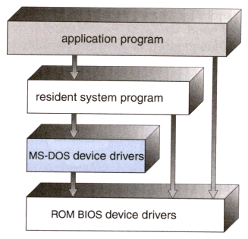
Simple Structure

Slide 11
Simple Structure
Operating systems such as MS-DOS and the original UNIX did not have well-defined structures.
There is no CPU Execution Mode (user and kernel), and so errors in applications can cause the whole system to crash.

Slide 12
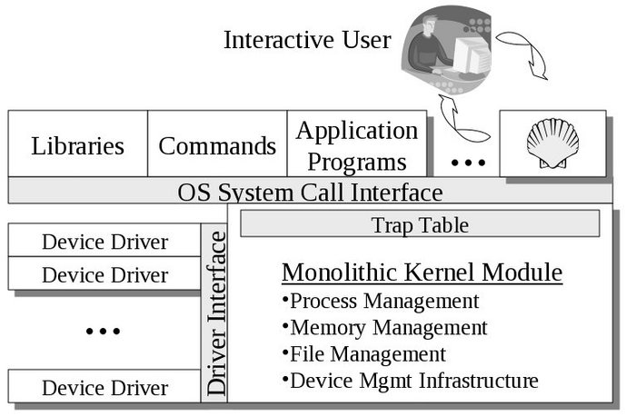
Monolithic Approach

Slide 13
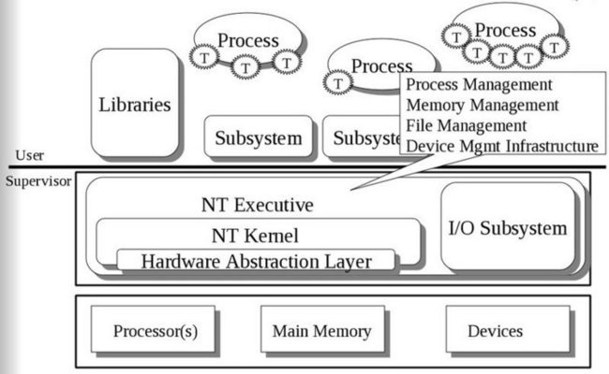
Layered Approach

Slide 14
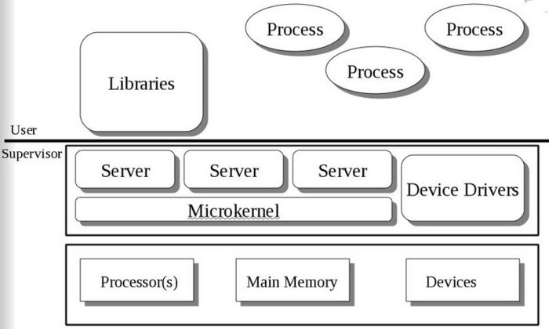
Microkernels

